Slide 1

Training Workshop
Session 6: Contact &
Dynamic FEA

Slide 2
ABAQUS Tutorial
Contact &
Dynamic FEA
Postprocessing
ABAQUS
Material &
Section Properties
Job Processing
(Solver)
Loading &
Analysis Steps
Meshing

Slide 3
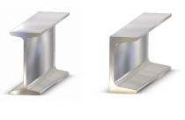
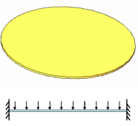
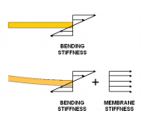
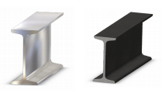
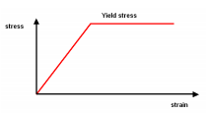
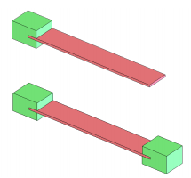
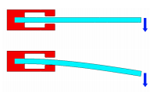
Nonlinear FEA
Shape
Material
Part Support

Slide 4
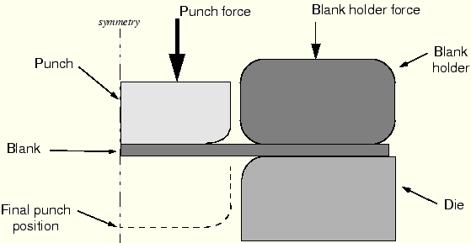
ABAQUS Contact
The forming of a channel
Part
  Rigid part(RF)
  Mirror sketch
Material
  Hardening
Assemble
  Edge to edge
Step
  Rigid body motion of the components – BC + 5steps
  Sudden changes in contact conditions
Interaction
  Surface def.
  Interaction prop def.
440 kN
A two-dimensional, symmetric ,plane strain model

Slide 5
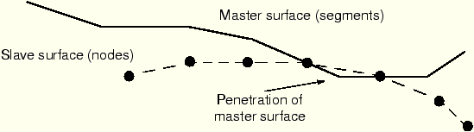
Slave and master surfaces
Nodes on one surface (the slave) cannot penetrate the other surface (the master)
  the slave surface should be the more finely meshed surface;
  if the mesh densities are similar, the slave surface should be the surface with the softer underlying material.

Slide 6

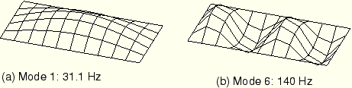
ABAQUS Dynamic
Element selection -- first-order elements
Mesh design

